Slide 1


Employee Data Analysis Using Excel
Student Name : Poojitha N
Register NO: 122202061
Department: Corporate secretaryship
College : ANNA ADARSH COLLEGE FOR WOMEN
Notes:
1

Slide 2
Project Tittle;
Employee performance analysis using Excel workspace

Slide 3
Agenda
Problem Statement
Project Overview
Modelling Approach
Using Methods and Charts
Results
Discussion
Conclusion

Slide 4
Problem Statement:
It is the dataset composition of the company of Jaganathan Chakravarthy private Limited located at the city Chennai, in the State of Tamil Nadu , India.
This is clearly informing about the information consisting of employee’s Employee ID, Name, Gender, Department, Salary, Start date, FTE, Employee type, Work location.

Slide 5
Project Overview:
This power point presentation clearly singnifies the calculation and analysis of dataset for the better ease of understanding of data analysis

Slide 6
Modelling Approach:
First, The data are clearly evolued in the form of perfect aspect excel .
Therefore, it will be formatted in column width and filter in the respective value of the rows and column.

Slide 7
Using Methods & Charts:
After the clearation of filtering the dataset and formatting the dataset.
Considering the data, it is classified as on the basis of Gender, Department, Employee type, Work location.

Slide 8
Results:
Therefore , the data is clearly picturizised in the forms of bar diagrams, charts, line diagram, and pie chart.

Slide 9
Disscussion:

Slide 10
Employee Type Classification:

Slide 11
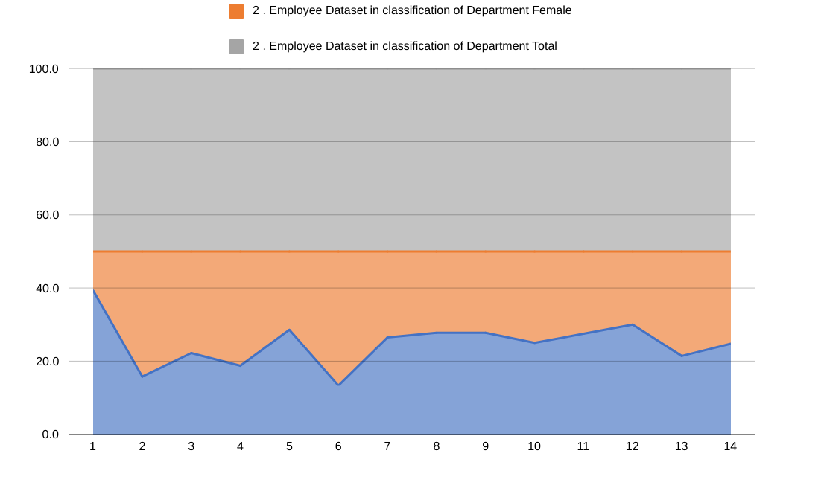
Department Classifictaion:

Slide 12
Gender Classification:

Slide 13
Conclusion:
The charts listed in the previous slides are the conluded analysis of the Jaganathan Chakravarthy Privarte limited company.

Slide 14


